Slide 1
School of Computer Science and Engineering B.Tech (CSE) 5th Semester(3rd Year)
INTERNSHIP PRESENTATION
INTERNSHIP TITLE : Cisco Virtual Internship Program 2026
INTERNSHIP ORGANIZATION : CISCO PROGRAM PARTNER : AICTE
COURSES COMPLETED:
Introduction to Modern AI
Apply AI: Analyze Customer Reviews
Data Analytics Essentials
STUDENT DETAILS :
NAME - AYAN MANDAL
ROLL NO - 2410030019
CLASS - 3CSE1
BRANCH - B.TECH CSE AIML

Slide 2
Outlook of Presentation
Title
About Cisco Networking Academy
About the Internship
Internship Learning Journey
Introduction to Modern AI
Modern AI: Techniques & Applications
Apply AI: Analyze Customer Reviews
Customer Review Analysis Workflow
Techniques Used in Customer Review Analysis
Data Analytics Essentials
Tools & Technologies
Data Analytics Workflow
Integration of All Three Courses
Practical Case Study
Skills Learned
Challenges & Solutions
Key Takeaways
Future Scope
Conclusion
All 3 Courses Certificate
Thank You

Slide 3

ABOUT CISCO NETWORKING ACADEMY
Cisco Networking Academy is a technology education initiative that provides industry-oriented learning and technical training.
It offers courses in areas such as Artificial Intelligence, Data Analytics, Networking, Cybersecurity, Programming, and emerging technologies.
The platform combines theoretical concepts with practical learning activities, assessments, and hands-on exercises.
Cisco Networking Academy helps students develop technical knowledge and industry-relevant skills.
The courses provide learners with opportunities to explore real-world applications of modern technologies.
Key Focus - Learn → Practice → Apply → Build Skills

Slide 4
My Cisco Learning Journey
Three Courses | One Learning Path
01 — INTRODUCTION TO MODERN AI
Learn the fundamentals of Artificial Intelligence and modern AI technologies.
02 — APPLY AI: ANALYZE CUSTOMER REVIEWS
Apply AI techniques to analyze real-world customer feedback and generate useful insights.
03 — DATA ANALYTICS ESSENTIALS
Learn how to organize, analyze, visualize, and communicate data-driven insights.
Overall Journey
AI Fundamentals → AI Application → Data Analytics → Business Insights

Slide 5
Course 1: Introduction to Modern AI
What is Modern AI?
Artificial Intelligence enables computer systems to perform tasks that normally require human intelligence, such as understanding information, recognizing patterns, generating content, and assisting with decision-making.
Major Topics Covered
Artificial Intelligence Fundamentals
Machine Learning
Generative AI
Computer Vision
Machine Translation
Chatbots
Prompting Techniques
Practical Applications of AI
Key Learning
AI can be used as a practical tool to solve real-world problems and improve productivity.

Slide 6
Techniques Learned in Modern AI
Technique | Application
Machine Learning | Learns patterns from data and supports predictions
Generative AI | Generates text, images, and other content
Computer Vision | Enables computers to understand images and videos
Chatbots | Provides conversational interaction with users
Machine Translation | Converts information between different languages
Prompting | Provides effective instructions to AI models
Real-World Applications
Healthcare
Education
Business
Customer Service
Automation
Content Generation
Data Analysis

Slide 7
Course 2: Apply AI — Analyze Customer Reviews
Problem Statement - Organizations receive thousands of customer reviews through websites, applications, and social media.
Manually analyzing these reviews is:
Time-consuming
Difficult to scale
Difficult to identify overall trends
Challenging when reviews contain different topics and languages
AI-Based Solution - AI can help analyze customer reviews and identify:
Topics
Themes
Sentiment
Customer concerns
Positive feedback
Common complaints
Improvement opportunities
Goal - Convert unstructured customer feedback into meaningful business insights.

Slide 8
Customer Review Analysis Workflow
CUSTOMER REVIEWS
↓
DATA PREPARATION
↓
TOPIC IDENTIFICATION
↓
THEME GROUPING
↓
SENTIMENT ANALYSIS
↓
HUMAN VERIFICATION
↓
INSIGHTS & RECOMMENDATIONS
Example Review
"The food was excellent, but the delivery was very slow."
AI Analysis
Food Quality → Positive
Delivery → Negative
Overall Sentiment → Mixed
Recommendation → Improve delivery speed

Slide 9
Techniques Used for Review Analysis
1. Data Cleaning - Remove duplicate, irrelevant, or unnecessary information.
2. Topic Identification - Identify the main subjects discussed in customer reviews.
3. Thematic Analysis - Group related topics into broader themes.
4. Sentiment Analysis - Identify whether feedback is positive, negative, or mixed.
5. Translation - Support analysis of reviews written in different languages.
6. Human-in-the-Loop - Review and verify AI-generated results to improve reliability.
7. Recommendations - Convert analytical results into actionable business suggestions.

Slide 10
Course 3: Data Analytics Essentials
What is Data Analytics?
Data Analytics is the process of collecting, organizing, analyzing, and visualizing data to discover useful information and support better decision-making.
Key Areas
Data Collection
Data Cleaning
Data Organization
Data Analysis
Data Visualization
Dashboards
Data Storytelling
Decision Making
Main Tools - Excel / Spreadsheets | SQL | Tableau
Key Learning - Data analytics transforms raw data into meaningful information and actionable insights.

Slide 11
Data Analytics Process
Example
Raw Sales Data
↓
Analyze sales by product, customer, and location
↓
Create charts and dashboards
↓
Identify trends and patterns
↓
Make data-driven business decisions
DATA COLLECTION
↓
DATA CLEANING
↓
DATA ORGANIZATION
↓
DATA ANALYSIS
↓
DATA VISUALIZATION
↓
INSIGHTS
↓
DECISION MAKING

Slide 12
TOOLS & THEIR ROLES
Tool | Role
Excel / Spreadsheets | Organizing, cleaning, calculating, and analyzing data
SQL | Retrieving, filtering, and analyzing data from databases
Tableau | Creating interactive visualizations and dashboards
AI Tools | Assisting with text analysis, classification, and insight generation
GitHub | Managing and sharing project files and building a portfolio
Tools Used in Data Analytics
Core Skills:
Data Analysis + SQL + Visualization + Data Storytelling

Slide 13
HOW ALL THREE COURSES CONNECT ?
From AI to Data-Driven Insights
INTRODUCTION TO MODERN AI
Learn AI Concepts
AI • ML • Generative AI • Computer Vision • Chatbots
FINAL OUTCOME -
BUSINESS INSIGHTS & BETTER DECISION-MAKING
APPLY AI: ANALYZE CUSTOMER REVIEWS
Apply AI to Real-World Data
Topics • Themes • Sentiment •Recommendations
DATA ANALYTICS ESSENTIALS
Analyze & Visualize Data
Excel • SQL • Tableau • Dashboards

Slide 14
MINI CASE STUDY
Step 1 — Collect Reviews
Gather customer feedback from different sources.
Step 2 — Apply AI
Classify reviews by topics and sentiment.
Step 3 - Identify Themes
Food Quality
Customer Service
Delivery
Price
Cleanliness
Step 5 — Business Decision
Improve delivery operations because delivery receives the highest negative feedback.
Step 4 — Analyze Results
Category | Result
Food Quality | Positive
Customer Service | Mixed
Delivery | Negative
Price | Positive
Cleanliness | Positive

Slide 15
SKILLS & LEARNING OUTCOMES
🤖 AI Skills
Artificial Intelligence Fundamentals
Machine Learning Concepts
Generative AI
Prompting
Chatbots
Computer Vision
💬 AI Application Skills
Customer Review Analysis
Thematic Analysis
Sentiment Analysis
AI-Assisted Classification
Human Verification
📊 Data Analytics Skills
Excel / Spreadsheets
SQL
Tableau
Data Visualization
Dashboards
Data Storytelling
💡 Professional Skills
Analytical Thinking
Problem Solving
Communication
Critical Thinking
Data-Driven Decision Making

Slide 16
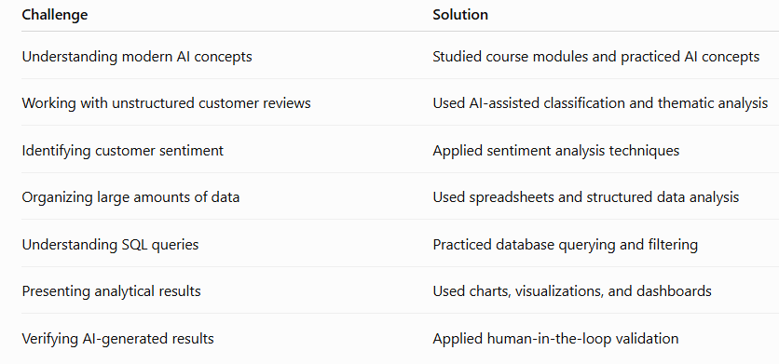
CHALLENGES & SOLUTIONS

Slide 17
KEY TAKEAWAYS
What I Learned
Developed a strong foundation in modern Artificial Intelligence.
Understood Machine Learning and Generative AI concepts.
Learned how prompting can improve interaction with AI tools.
Learned how AI can analyze customer reviews and identify useful patterns.
Understood thematic and sentiment analysis.
Learned the fundamentals of data analytics.
Gained knowledge of Excel, SQL, and Tableau.
Understood the importance of data visualization and storytelling.
Learned how data can support business decisions.
Understood the connection between AI, Data Analytics, and real-world applications.

Slide 18
FUTURE SCOPE
Future Applications
The knowledge gained from these courses can be extended to:
AI
Generative AI Applications
AI Chatbots
Computer Vision
Recommendation Systems
Data Analytics
Predictive Analytics
Business Intelligence , Customer Analytics , Automated Dashboards
Combined AI + Analytics
AI-Powered Business Intelligence
Customer Sentiment Monitoring
Automated Review Analysis
Intelligent Recommendation Systems
Predictive Customer Behavior Analysis
Career Areas - Data Analyst | AI/ML Engineer | Business Intelligence Analyst | Data Scientist

Slide 19
CONCLUSION
The three Cisco courses provided a progressive learning experience in AI and Data Analytics.
Introduction to Modern AI established the fundamentals of modern AI technologies.
Apply AI: Analyze Customer Reviews demonstrated how AI can be applied to real-world text data.
Data Analytics Essentials provided knowledge of data analysis, SQL, visualization, and dashboards.
Together, these courses helped develop the ability to move from raw data → AI analysis → visualization → actionable insights.
The learning experience provides a strong foundation for further studies and projects in AI/ML and Data Analytics.

Slide 20
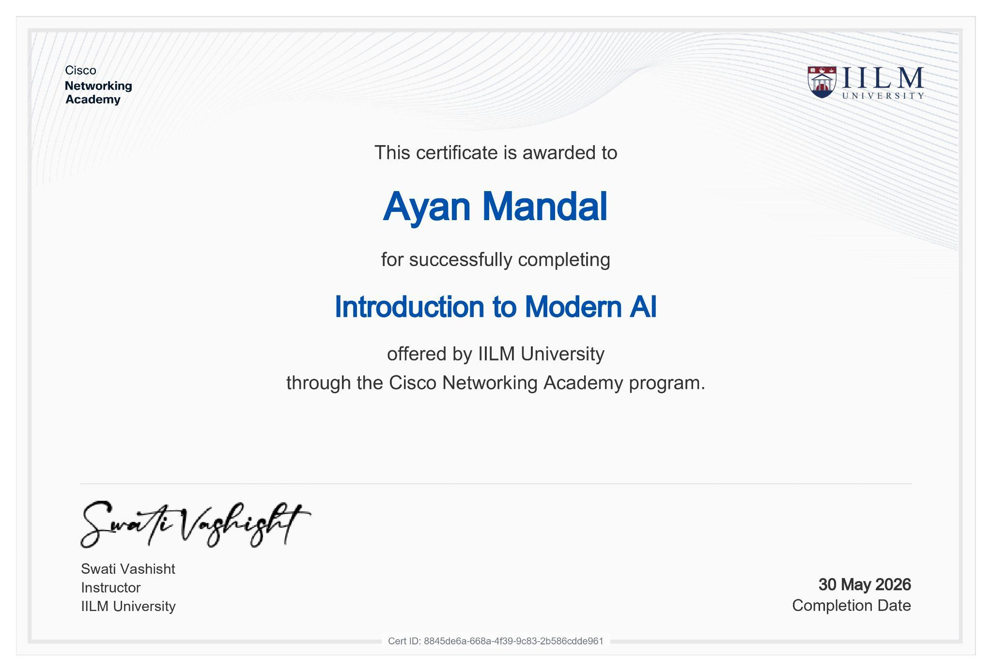
Course 1 : Introduction to Modern AI Certificate

Slide 21
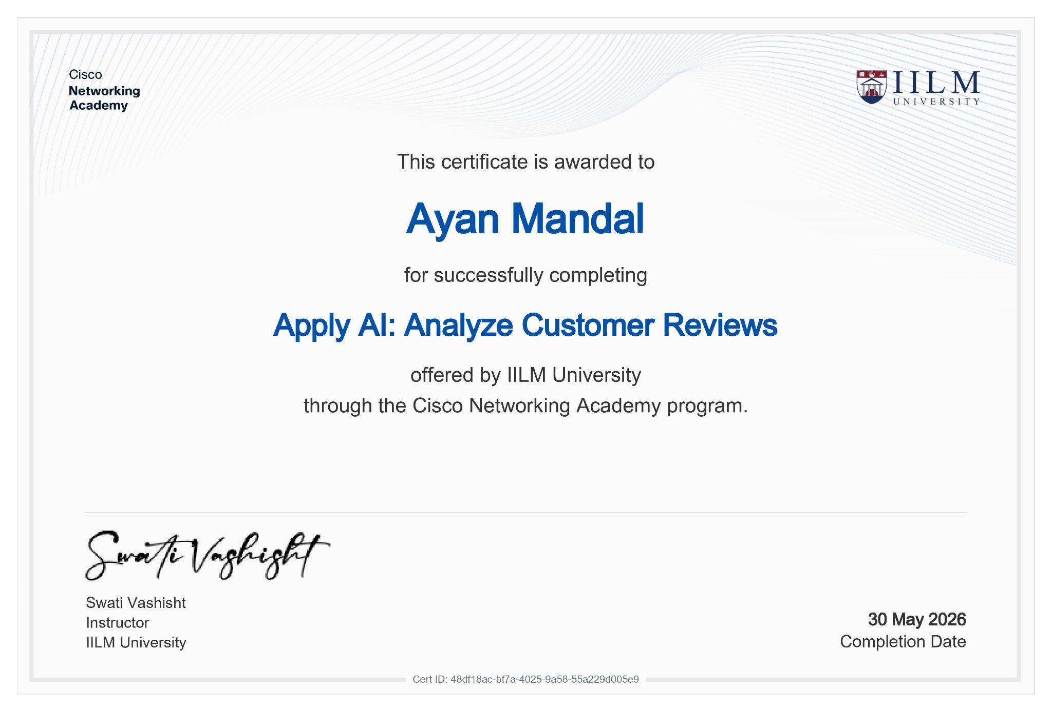
Course 2 : Apply AI: Analyze Customer Review

Slide 22
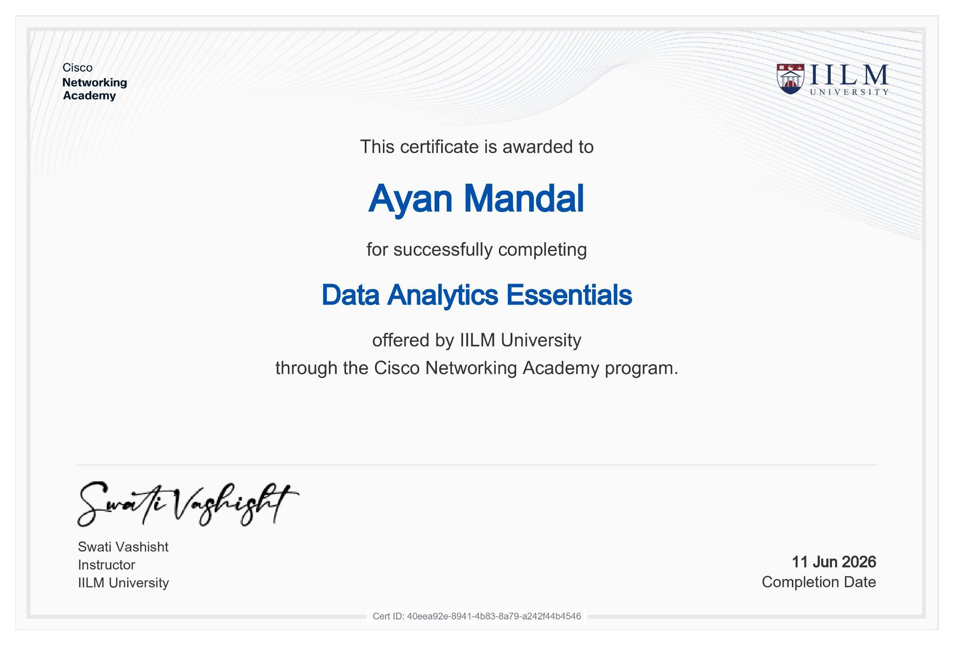
Course 3 : Data Analytics Essentials

Slide 23
Thank You

